Slide 1
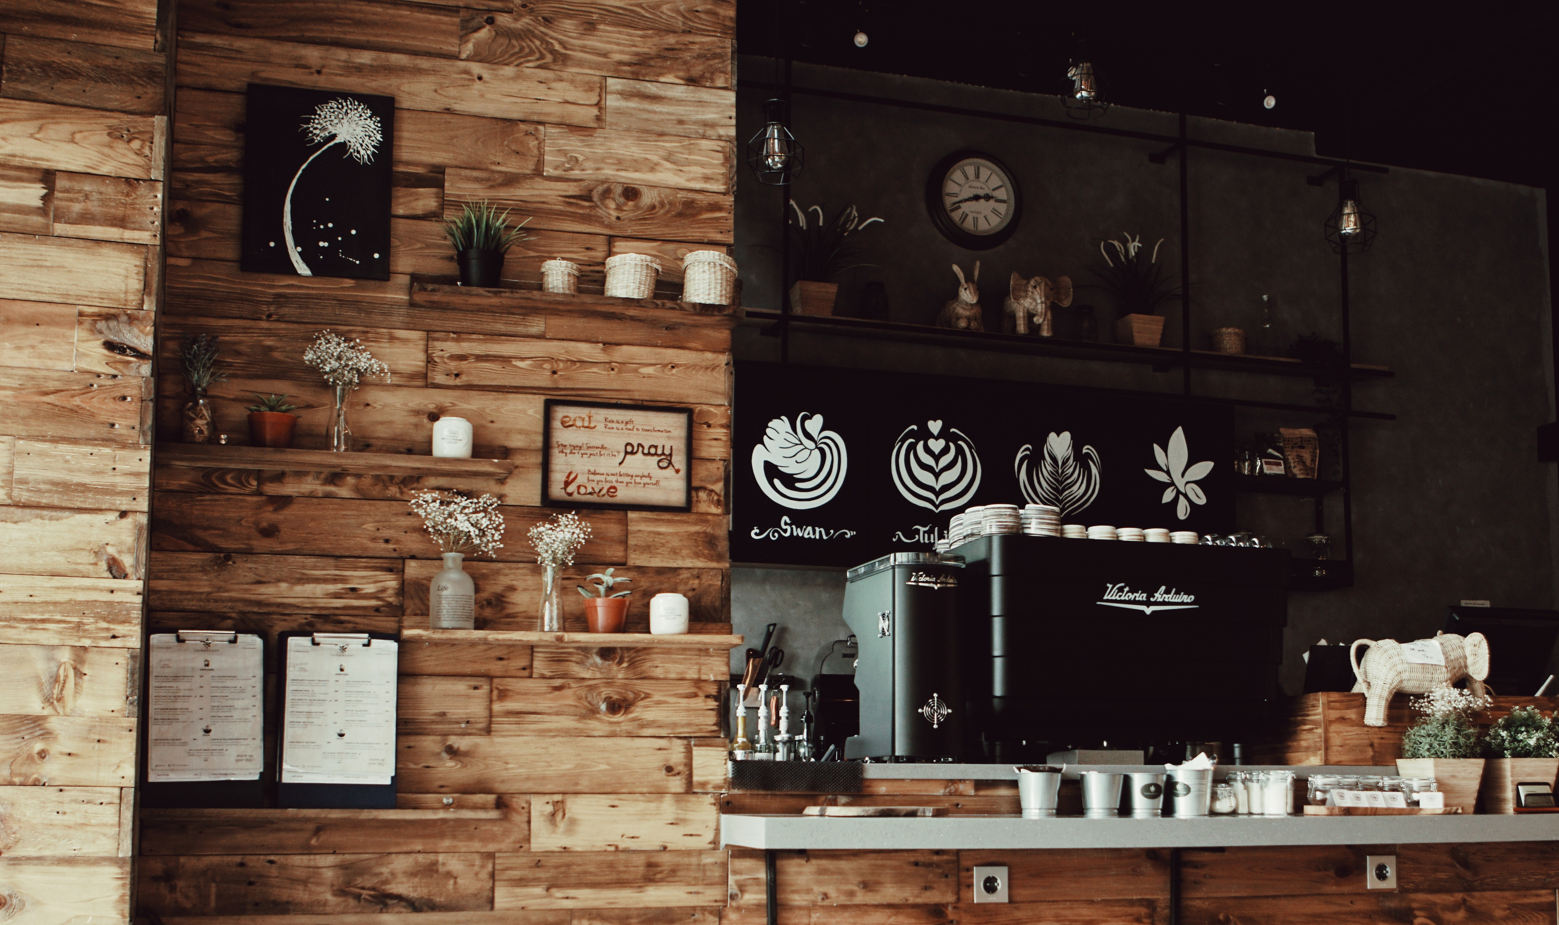


Slide 2
TEAM MEMBERS
ASTHA CHAUHAN
PRACHI SINGH
SHRUTI SHARMA
YASHI MISHRA

Slide 3
INTRODUCTION
Overview
Motivation
Caffeine Era is a MERN stack project based on a coffee shop that offers a world-class coffee to our lovely customers. The application provides very simple steps in which a customer cannot find any difficulty to order for himself. The Application is designed in such a manner that one cannot be spelt without the other, there are the hot coffee or cold coffee combinations with delectable desserts and speciality coffee and eats combinations for even a group of friends.
Coffee has been around in India since the 17th century. And 80% of the population is like coffee. We all know that Coffee Café is one of the most popular hangout places. Coffee is very famous among youngsters. Coffee is one of the favorite beverages and has become more appealing because of its variety.
Our Motivation is to be the best Website by offering a world-class coffee experience at affordable prices.

Slide 4
OBJECTIVE
The main objective of our project CAFFEINE ERA is to reach worldwide customers via Website by offering a world-class coffee experience at affordable prices.
The offering is designed in such a manner that one cannot be spelt without the other, there are the hot coffee or cold coffee combinations with delectable desserts.

Slide 5
WORKING METHODOLOGY

Slide 6
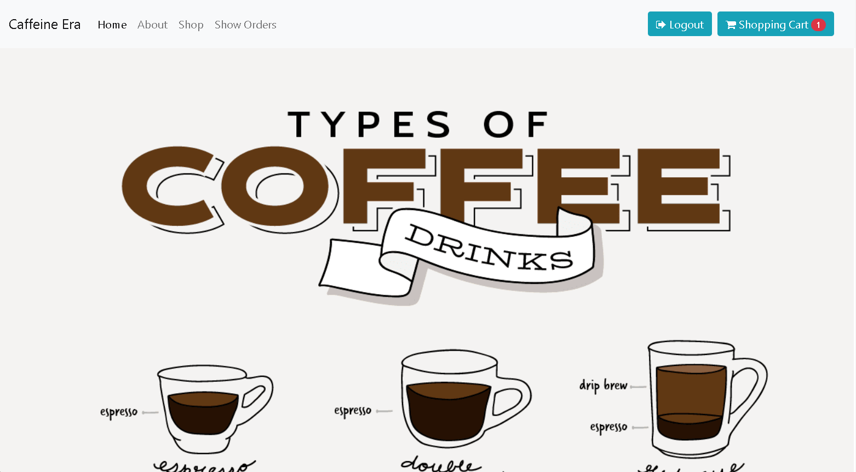
HOME PAGE

Slide 7
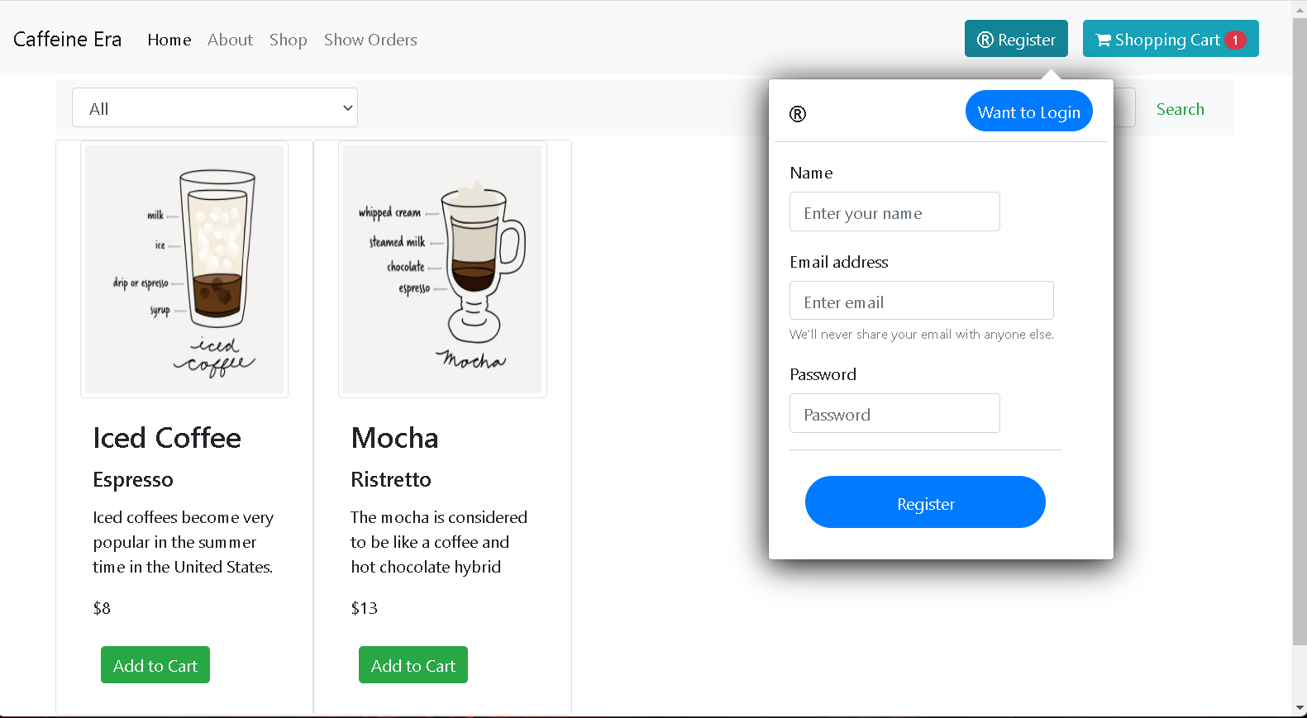
REGISTER

Slide 8
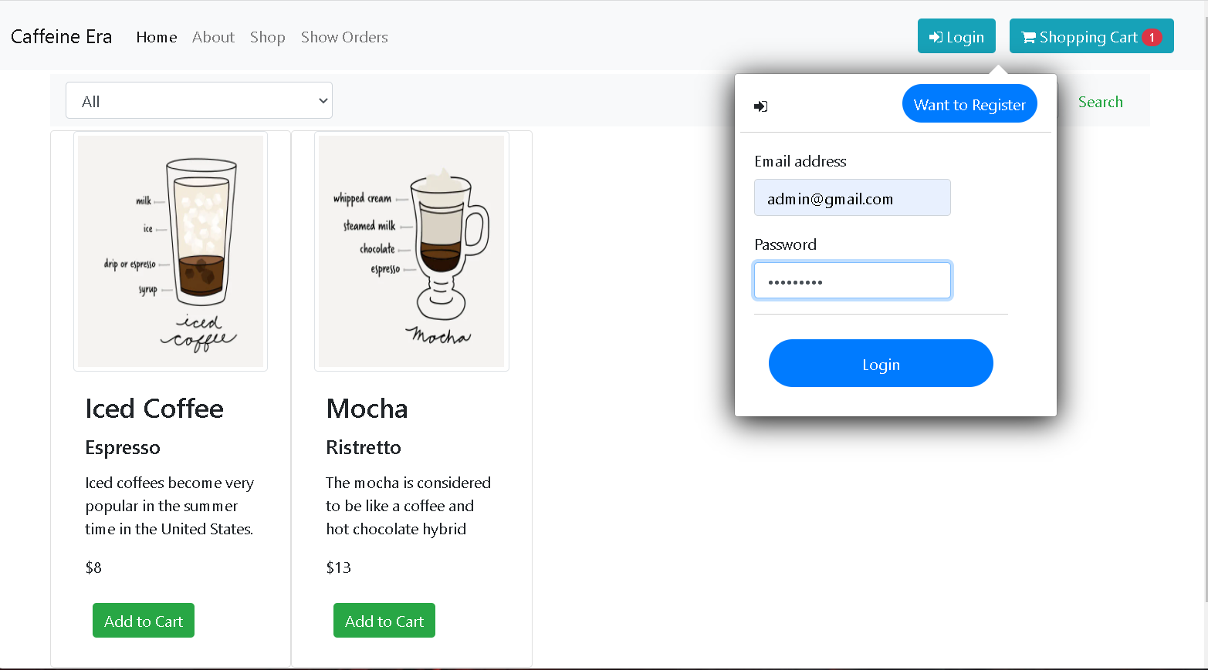
LOGIN

Slide 9
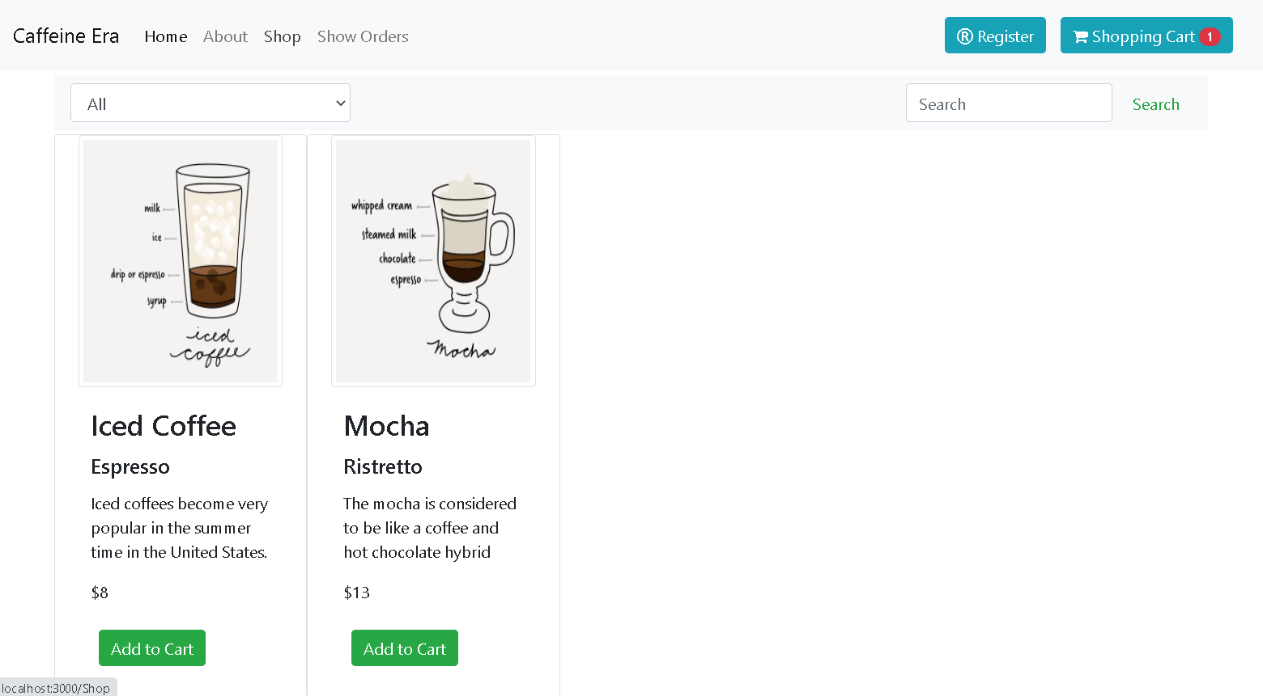
SEARCH

Slide 10
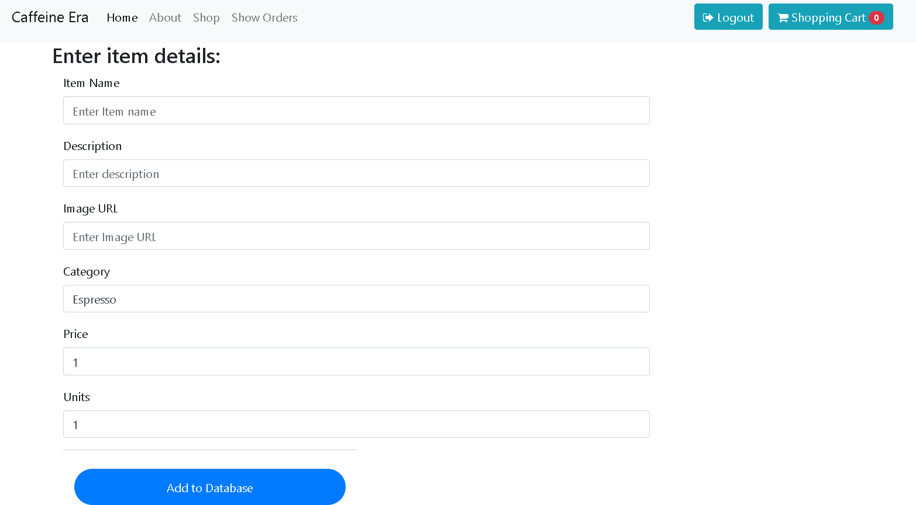
INSERT ITEM

Slide 11
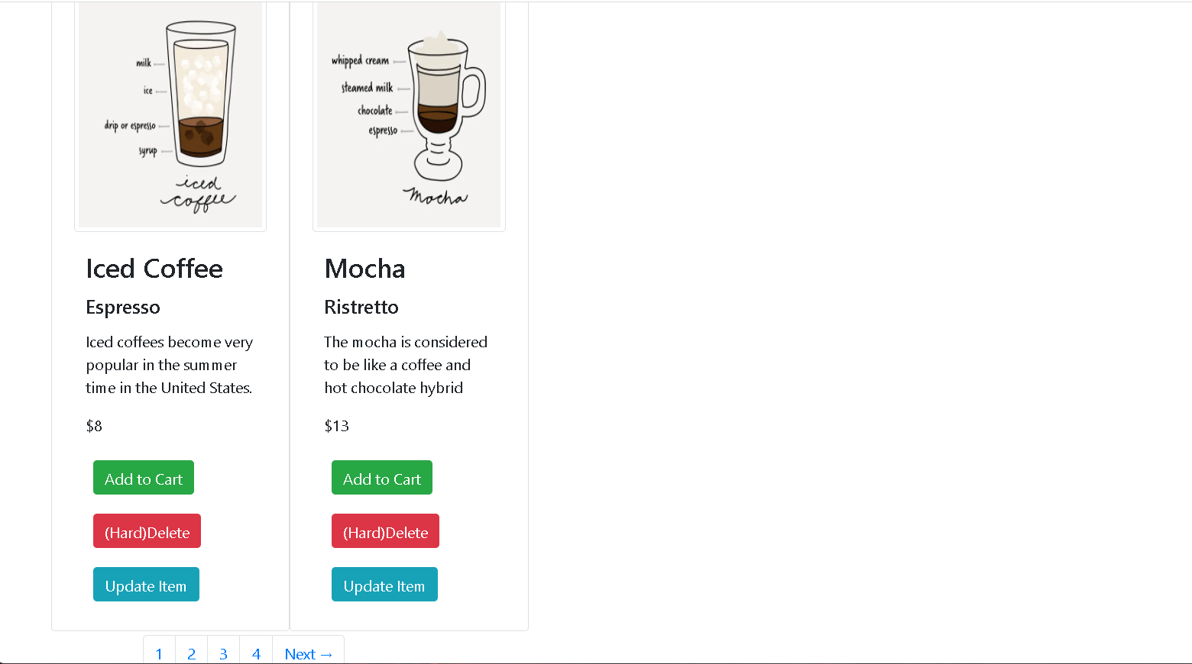
UPDATE/ DELETE ITEM

Slide 12
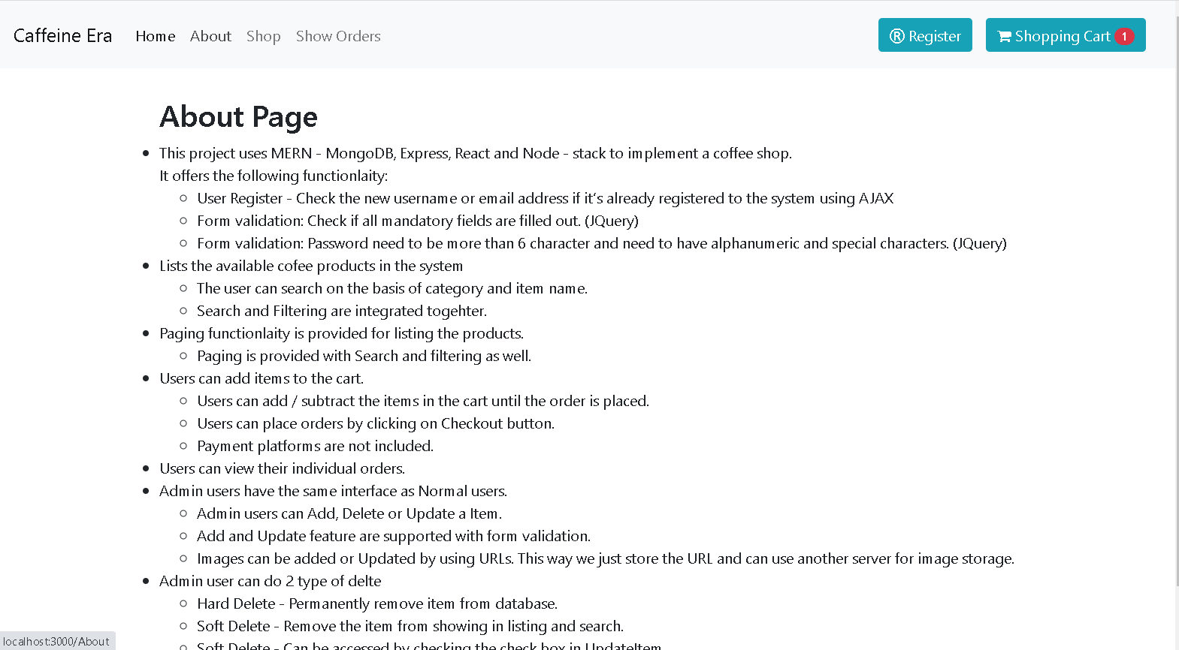
ABOUT

Slide 13
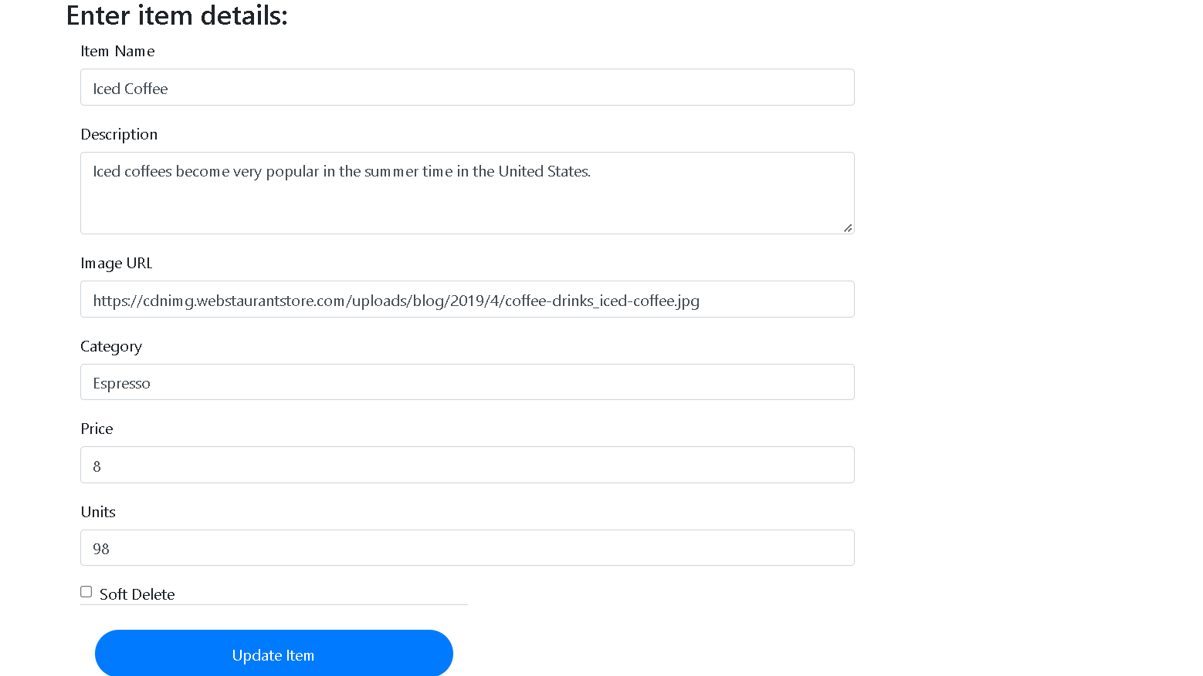
UPDATE ITEM

Slide 14
SHOP

Slide 15
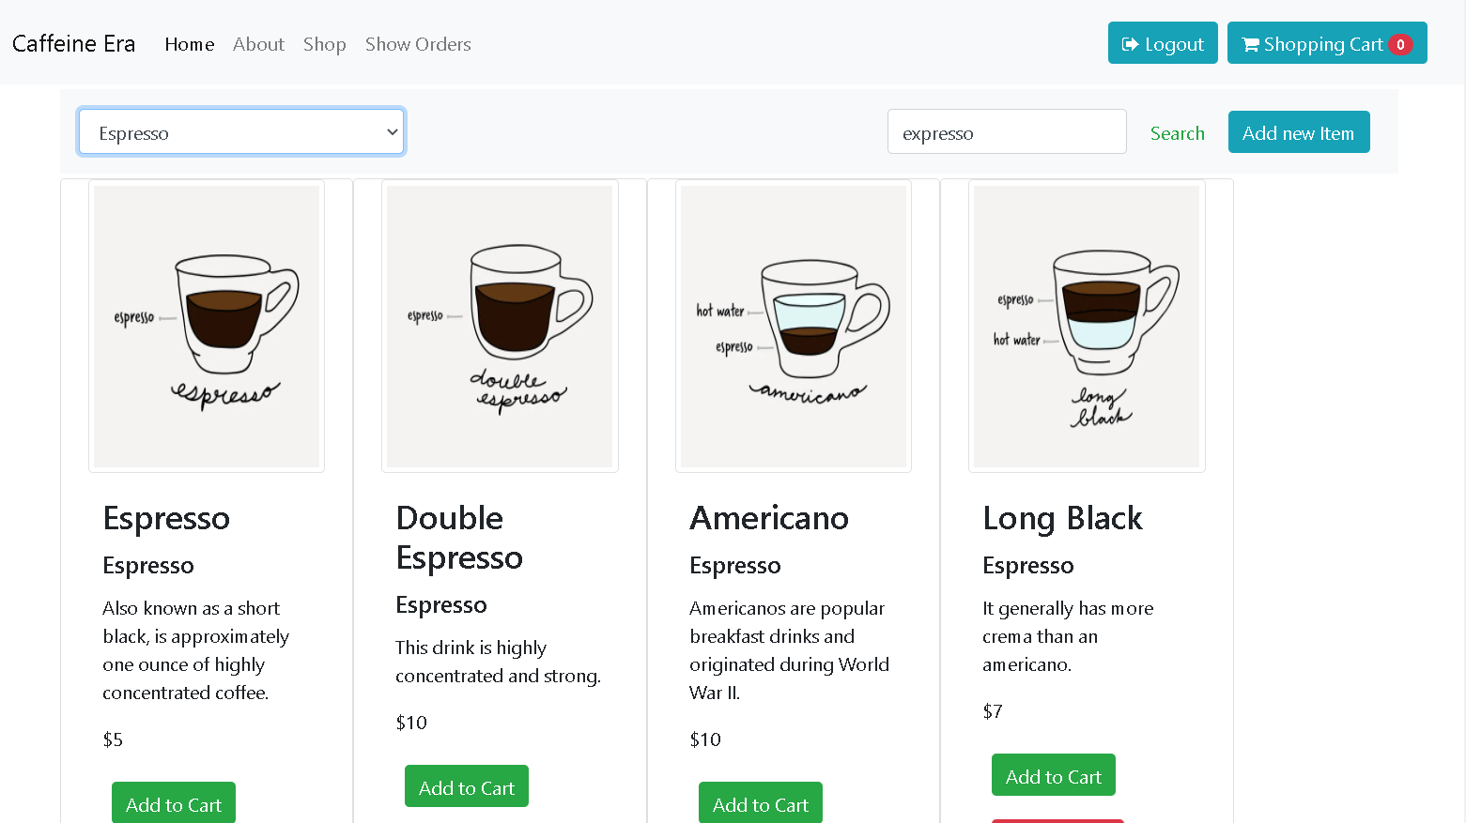
SHOP BY CATEGORY

Slide 16
SHOP BY CATEGORY

Slide 17
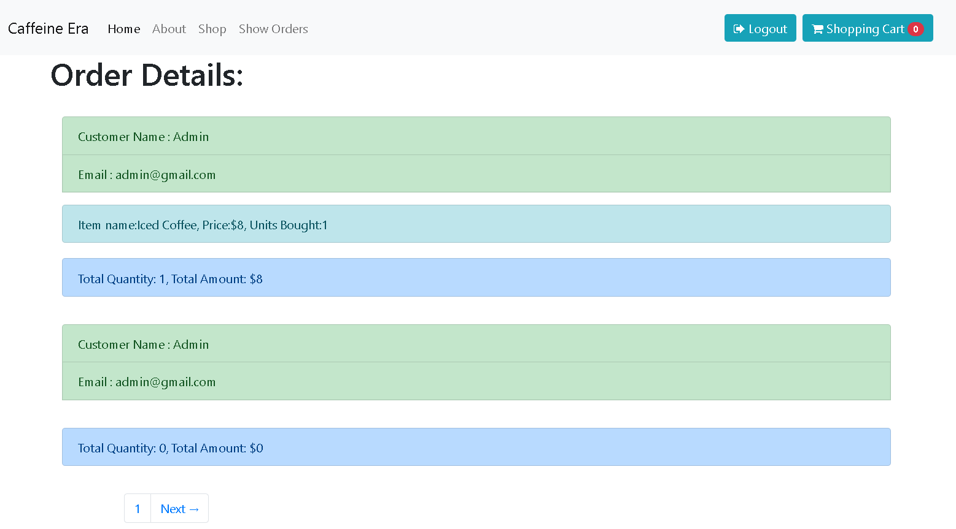
ORDER LIST

Slide 18
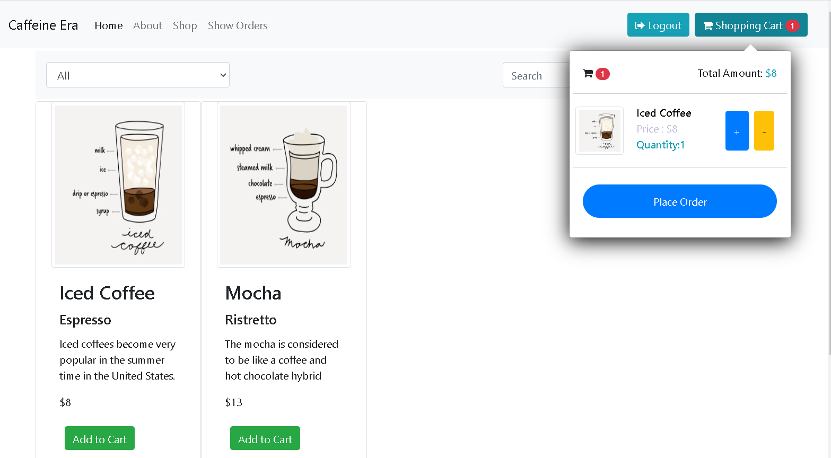
CART

Slide 19


